Slide 1
202305汕头市二模
英语教学教研工作坊 编制
推荐信
推荐合适的旅游及学习
中国文化的目的地

Slide 2
审 题
假如你是李华, 你的英国笔友Richard 计划今年暑假来中国旅游并学习中国
文化, 请你写信给他, 内容包括：
1. 推荐合适的目的地；2. 说明理由。
注意：1. 写作词数应为80左右；2. 请按如下格式在答题卡的相应位置作答。
文体：
主题：
推荐信
旅游目的地
要点：
1. 写作目的；
2. 给予推荐及理由;
3. 总结并表达祝愿。
时态：
人称：
一般现在时为主，一般将来时为辅。
第二人称及第三人称

Slide 3
框架构思
框架构思
Para 1：开头：写作目的；
Para 2：正文：推荐目的地并给出理由;
Para 3：结尾：总结并表达祝愿。

Slide 4
Brainstorm
历史博物馆：
了解中国的历史。
吃当地美食：
体验中国博大精深的饮食文化。
旅游及学习中国文化的目的地
观看当地的名胜古迹：
可以更加好地体验当地的人文。
欣赏当地艺术或者非遗项目：
可以了解当地文化。

Slide 5
核心词汇
highly recommend sth./ made recommendations
cultural and historical sites
extensive and profound Chinese culture
demonstrating the beauty of Chinese culture
breathtaking natural wonders
Chinese classic works
cultural immersion
推荐
文化和历史场所
博大精深的中国文化
展示中国文字的美丽
惊人的自然景观
中国文学经典
文化渗透

Slide 6
高分开头
1.非常高兴得知你将访问我的家乡广州，珠江三角洲一个高度发达的城市，我忍不住表达我的兴奋。在此，我想强烈向你推荐一些著名的景点，我相信它们一定会让你着迷。
Exceedingly delighted to be informed that you will pay a visit to my hometown Guangzhou, a highly developed city in the Pearl River Delta, I can’t help voicing my great excitement. Here I’d like to highly recommend some far-famed scenic spots to you, which I believe will surely make you fascinated.

Slide 7
高分开头
2.得知你迫切需要一个合格的/称职的导游，我写信推荐我的同学李明，坦白地说，我相信他能满足你的要求
Learning that you are in desperate/urgent need of a qualified /competent tour guide, I’m writing to recommend Li Ming ,a schoolmate of mine, without reservation, who I believe will satisfy your requirements
3.很高兴你对四大名著产生了浓厚的兴趣，我非常愿意向你推荐《西游记，适合中国文学初学者
Thrilled to know that you’ve grown a deep interest in the Four Great Classical Novels, I’m extremely willing to recommend Journey to the West to you, which is fit for beginners in Chinese Literature

Slide 8
高分结尾
1.无论如何，你无法想象这是一场多么视觉上的盛宴，除非你亲自去探索它
Anyway, you can’t imagine what a visual feast it is unless you go and explore it in person
2.如果我的建议得到您的良好考虑，我将不胜感激。如需更多详细资料，请随时联系我或查阅他的简历及申请信。
Should my recommendations gain your favorable consideration, it would be highly appreciated. For more detailed information, you can feel free to contact me or refer to his resume and application letter enclosed.

Slide 9
高分结尾
3.如果你喜欢他这个职位，他就会证明自己是一个无与伦比的向导，永远不会不辜负你的期望。我衷心希望您能在方便的时候尽早安排一次会见他。如果需要更多的信息，请随时与我联系。
Should you favor him with the position, he would demonstrate himself as an unparalleled guide and would never fail to live up to your expectations. I sincerely hope that you can schedule an interview with him at your earliest convenience. If more information is needed, please don’t hesitate to contact me.

Slide 10
Brainstorm---Beijing
Beijing, with a history of over 3,000 years, has been the political and cultural center of China since ancient times. The city has witnessed the rise and fall of numerous dynasties and served as the imperial capital for centuries. It is home to some of the world's most iconic cultural landmarks such as the Forbidden City, the Temple of Heaven, and the Great Wall. Beijing is also famous for its traditional arts and crafts such as Beijing opera, cloisonne, and Peking duck cuisine. The city is a vibrant mix of ancient culture and modernization and offers a unique and unforgettable experience for those who visit.

Slide 11
Brainstorm--- Xian
Xi'an is a city in China with a rich history and culture. It was
the capital of 13 dynasties and played a significant role in the
development of Chinese civilization. The city is home to the
Terracotta Warriors, a UNESCO World Heritage Site which is a
collection of life-sized sculptures depicting the armies of the
first emperor of China. Xi'an is also known for its ancient city
walls, which date back to the Ming Dynasty, and the Big Wild Goose Pagoda, a Buddhist temple built in the Tang Dynasty. The city's cuisine is also famous, with dishes such as roujiamo (Chinese hamburger)and biang biang noodles. Xi'an is a must- visit destination for anyone
interested in Chinese history and culture.

Slide 12
Brainstorm---Qufu
Qufu is an ancient city in Shandong Province, China, known as the birthplace of Confucius, the great philosopher and educator. With a history of over 2,500 years, Qufu is a UNESCO World Heritage Site, boasting three key cultural landmarks: the Temple of Confucius, the Cemetery of Confucius, and the Kong Family Mansion. Visitors can immerse themselves in traditional Chinese architecture, learn about the life and teachings of Confucius, and appreciate the deep influence of Confucianism on Chinese culture. Come and explore this remarkable city to experience the charm of China's history and philosophy.

Slide 13
Brainstorm---Nanjing
Nanjing, located in eastern China, is a city with rich cultural heritage and dramatic historical significance. As one of China's ancient capitals, it has witnessed numerous dynasties, wars and modernization. The city is home to many important historical sites. For example, the Ming Xiaoling Mausoleum, a UNESCO World Heritage site, is the burial place of Emperor Zhu Yuanzhang, the founder of the Ming Dynasty. It is considered one of the finest examples of Ming Dynasty architecture. The city is also home to the Nanjing Massacre Memorial Hall, dedicated to the victims of the Japanese occupation during World War II. In addition, the well-preserved traditional neighborhoods and local delicacies make Nanjing a hidden gem for tourists interested in the traditional Chinese lifestyle and culture.

Slide 14
Brainstorm---Luoyang
Luoyang is a city in central China that is renowned for its rich cultural and historical significance. As one of the ancient capitals in China, it served as the political, economic, and cultural center of the country for over 1,000 years. The Longmen Grottoes, a UNESCO World Heritage Site, houses thousands of intricate and well-preserved Buddhist statues and carvings dating back to the Tang dynasty. Meanwhile, the White Horse Temple, the first Buddhist temple in China, marks the beginning of Buddhism's spread in the country. The city is also well-known for the stunning Peony Blossom Festival, an annual celebration that showcases the beauty and elegance of China’s national flower. Visiting Luoyang is a unique opportunity for foreigners to experience China’s fascinating history and culture.

Slide 15
Brainstorm--- Chengdu
Chengdu, the capital of Sichuan Province, is a city with a rich history and culture. Known as the "Land of Abundance", Chengdu has been an important center of trade and commerce since ancient times. The city is famous for its spicy Sichuan cuisine, tea culture, and traditional Chinese medicine. Chengdu is also home to many historical and cultural sites, such as the Wuhou Shrine, Jinsha Site Museum, and Du Fu Thatched Cottage. The city is also a gateway to the nearby Leshan Giant Buddha and Mount Emei, both UNESCO World Heritage Sites. With its unique blend of history, culture, and modernity, Chengdu is a must-visit destination for anyone interested in experiencing the best of China.

Slide 16
评分标准
A. 评分原则
1. 本节满分 15 分，按 5 个档次给分，精确到 1 分。
2. 评分时，先根据文章的内容和语言初步确定其档次，然后以该档次要求衡量，确定或调整档
次，最后给分。
3. 词数少于 50 的，从总分中减去 1 分。多于 110、但都是有效表达，不扣分。
4. 评分时应关注内容要点、应用词汇和语法结构的丰富性、准确性及上下文的连贯性。
5. 拼写与标点符号是语言准确的一个方面。评分时，应视其对交际的影响程度予以考虑。英、美拼写及词汇用法均可接受。
6. 如书写较差以至影响交际，将其分数降低一个档次。
B. 内容要点
1. 简述写信缘由和目的（基础性，略写）；无需自我介绍，若有，酌情扣一分。若有学生第一段套用句子不恰当，酌情扣分，关键看第二段是否提出相关建议。
2. 提出活动建议（详写、拓展部分：提出2-3个与中国文化相关的建议，并说明理由，理由可以是
意义、好处和目的等，但都得围绕着“中文日”活动来展开。
3. 总结，表达期待录制和分享，并祝愿活动成功等（略写）。
说明：内容要点可用不同方式表达；内容可适当拓展，但应紧扣主题。
C. 各档给分范围与要求
1. 快速确定评分档次

Slide 17
评分标准
B. 内容要点
1. 简述写信缘由和目的（基础性，略写）；无需自我介绍，若有，酌情扣一分。若有学生第一段套用句子不恰当，酌情扣分，关键看第二段是否提出相关建议。
2. 提出活动建议（详写、拓展部分：提出2-3个与中国文化相关的建议，并说明理由，理由可以是
意义、好处和目的等，但都得围绕着“中文日”活动来展开。
3. 总结，表达期待录制和分享，并祝愿活动成功等（略写）。
说明：内容要点可用不同方式表达；内容可适当拓展，但应紧扣主题。

Slide 18
评分标准
档次 | 给分 | 比例 | 评分标准
第五档 | 13-15 | 20% | 语言基本无误，行文连贯，表达清楚，有亮点表达
第四档 | 10-12 | 50% | 语言有少量错误，行文基本连贯，表达基本清楚
第三档 | 7-9 | 24% | 语言有一些错误，尚能表达
第二档 | 4-6 | 5% | 语言错误较多，影响表达
第一档 | 0-3 | 1% | 只能写出与要求内容有关的一些单词

Slide 19
应用文高考评分标准
分值 | 评分标准说明
第一档： 13-15分 | 完全完成时试题规定的任务。覆盖了所有内容要点；运用了多样丰富的地道和得体的句式与词汇；语法和用词方面有个别错误，但为尽可能表达丰富内容所致；体现了较强的语言运用能力；有效地使用了语句间连接成分，逻辑清晰合理，所写内容连贯、紧凑，完全达到了预期的写作目的。
第二档： 10-12分 | 完全完成时试题规定的任务。覆盖了所有内容要点；运用的句式与词汇能满足任务要求；语法和用词方面基本准确、有少许错误，为尽可能表达丰富内容所致；使用了简单句间的连接成分，逻辑清晰合理，所写内容连贯，达到预期的写作目的。
第三档： 7-9分 | 覆盖了主要内容要点；运用的句式与词汇基本能满足任务要求；语法和用词方面有一些错误，但不影响理解；基本达到预期的写作目的。
第四档： 4-6分 | 未恰当完成试题规定的任务，漏掉或未清楚描述主要内容，所用句式和词汇有限，语法或用词方面的错误影响了对所写内容的理解，未能清楚地传达信息。
第五档： 1-3分 | 未完成试题规定的任务，明显遗漏主要内容。句式单调、词汇贫乏。语法或用词方面错误较多，严重影响了对所写内容的理解
0分档 | 未能传达任何信息：所写内容与要求无关。

Slide 20
应用文高考考核的能力
GRA:
Grammatical
Range and Accuracy
（语法范围与精确性)
语言能力
思维能力
LR:Lexical Resource
（词汇资源)
CC: Coherence & Cohesion
（内容连贯与篇章衔接）
TA: Task Achievement(任务完成)--1
TR: Task Response(任务回应)--2

Slide 21
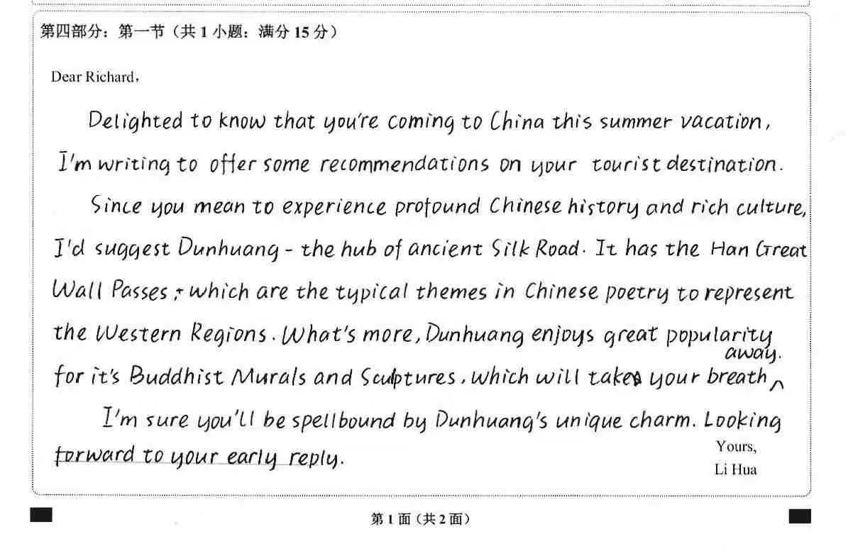
优秀学生习作
文章结构完整，层次清晰，行文流畅。词汇丰富，语言驾驭能力强。

Slide 22
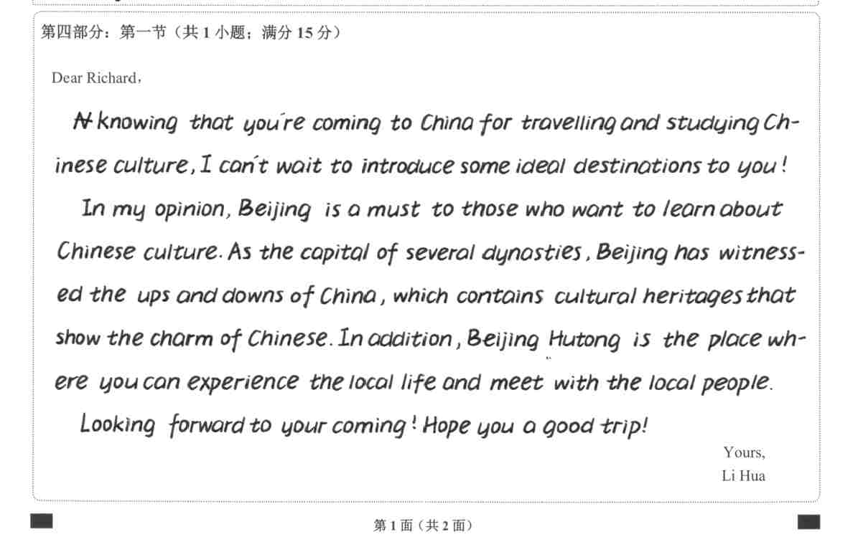
优秀学生习作
要点表述清晰，内容详实、具体；能使用较为准确丰富的词汇，段落间的逻辑较清晰，能恰当使用不同的句型完成写作任务

Slide 23
范文1
Dear Richard,
Learning that you plan to have a study tour in China,I would like to extend my warmest welcome and recommend Beijing as your destination.
Beijing, one of the oldest cities in the world and the capital of China, typically represents Chinese traditional culture. In Beijing, not only can you visit Chinese ancient architecture like the Forbidden City, but you will also immerse yourself in the atmosphere of Chinese folk life by experiencing Peking Opera. What’s more, I’m sure you won’t miss the Chinese traditional cuisines while traveling. Definitely, the visit will deepen your understanding of the eastern civilization.
If you have any other question please feel free to contact me! Wish you a pleasant journey in China!(118 words)
Yours,
Lihua

Slide 24
范文2
Dear Richard,
Thrilled at your plan to travel in China and learn Chinese culture, I’m extending my sincerest welcome and making a recommendation.
Learning while travelling is getting increasingly well-received. When the iconic attractions are mentioned, you will find Qufu included, the hometown of Confucius, who greatly shaped Chinese cultures. Walking in the famous Three Kong-Confucian Temple, Cemetery and Family Mansion, you can entirely gain deep insight into Chinese value and philosophy while exposing yourself to the harmony of human and nature.
Qufu should top your list, which is definitely a gateway to the profound Chinese culture. Wish you a brilliant tour and a good harvest. Hardly wait to meet you in person.
Yours,
Lihua

Slide 25
及格版下水作文
Dear Richard,
Hearing you want to visit some places in China to experience Chinese culture, I am glad to introduce you some interesting places. Here are the details.
First, Beijing is the first place that I would like to reccommend to you. In Beijing, there are thousands of cultural and historical sites ranging from History Museum to local parks, where you can experience the extensive and profound Chinese culture. Secondly, it is necessary to taste some delicious Chinese cuisine, by which you can go through some Chinese cooking culture. At last, going to visit some ancient buildings is also a must, which can help you have a better understanding of Chinese architectures. They are definitely a symbol of Chinese culture.
In a word, I highly recommend Beijing to you to have an unforgettable travel experience. It is truly a destination that you can not miss. Wish you a pleasant journey in China!
Yours,
Lihua

Slide 26
及格版下水作文默写
Dear Richard,
________________________________(听说你要来中国旅游) to experience Chinese culture, I am glad to introduce you some interesting places. ____________________________(细节如下).
First, Beijing is the first place that I would like to reccommend to you. In Beijing, there are thousands of ______________________(历史和文化圣地) ranging from History Museum to local parks, where you can experience ________________________________(意义深远的中国文化) . Secondly, it is necessary to taste some delicious Chinese cuisine, by which you can go through some Chinese cooking culture. At last, going to visit some ancient buildings is also a must, ________________________________(这些可以很好地让你理解) of Chinese architectures. It is a symbol of Chinese culture.
In a word, I ________________________________(非常推荐北京给你) to have an unforgettable travel experience. I hope this trip will be of great interest for you. It is truly a destination that you can not miss.
Yours,
Lihua

Slide 27
优秀版下水作文
Dear Richard,
Knowing that you are coming to China to travel and explore some Chinese culture, I am writing to highly recommend Beijing as a top destination for you to experience the beauty of culture.
First of all, you can go to visit the History Museum in Beijing, where items dating back thousands of years are exhibited. These cultural and historical sites can make a truly unique and educational experience for you.What’s more, through exploring the ancient temples and breathtaking natural wonders, you can really blend in this city. Last but not the least, indulging in the delicious local cuisine is also a fantastic way to experience the charming culture. Undoudtedly, there are endless possibilities for gaining a deeper understanding and appreciation of this rich and fascinating country.
Therefore, I highly recommend Beijing to anyone looking for an unforgettable travel experience that combines fascinating scenery with cultural immersion. It is truly a destination like no other.
Sincerely yours,
Li Hua

Slide 28
优秀版下水作文默写
Dear Richard,
________________________________(听说你要来中国旅游) and explore some Chinese culture, I am writing to ________________________________(首要推荐北京给你) for you to experience the beauty of culture.
First of all, you can go to visit the History Museum in Beijing, where ________________________________(物品有上千年的历史) are exhibited. These cultural and historical sites can ________________________________(真的使得这次旅行有教育和文化意义) for you.What’s more, through exploring the ancient temples and breathtaking natural wonders, you can ________________________________(完全融入这个城市) . Last but not the least, indulging in the delicious local cuisine is also a fantastic way to experience the charming culture. Undoudtedly, there are endless possibilities for __________________ (来更好地了解和体验这个富有和迷人的国家) .
Therefore, I highly recommend Beijing to anyone looking for an unforgettable travel experience that ________________________________(结合了迷人的风景和深刻的文化体验) . It is truly ________________________________(将是一个独一无二的旅行) .
Sincerely yours,
Li Hua

